Slide 1
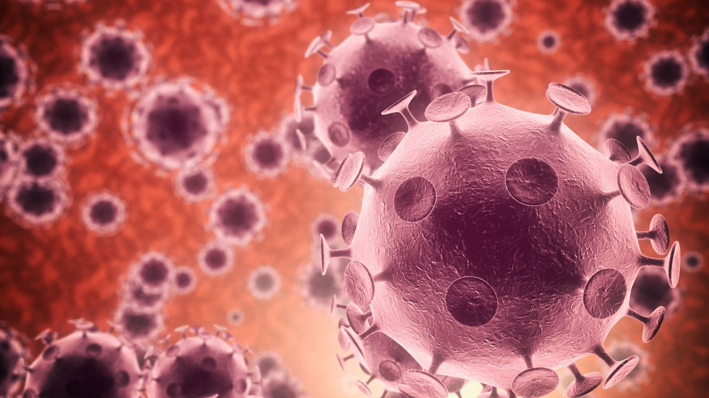
Developments in Disease
GTHBY Human Biology

Slide 2
Review
What did Hippocrates call the “bad air” that made people get sick?
Why was this theory about how diseases spread take so long to be proven wrong?
Which disease was Girolamo Fracastoro studying when he came up with his “seeds of disease” idea.
What does contagium vivium mean?

Slide 3
Learning Intentions
Use of microscopes to dispel myths and misconceptions of disease

Slide 4
Success Criteria
Explain how our understanding of infectious disease has evolved with developments in technology, including microscopes.

Slide 5

3 case studies
While we are reading, write 5 questions you want to find the answer to, each on a different post it note.

Slide 6
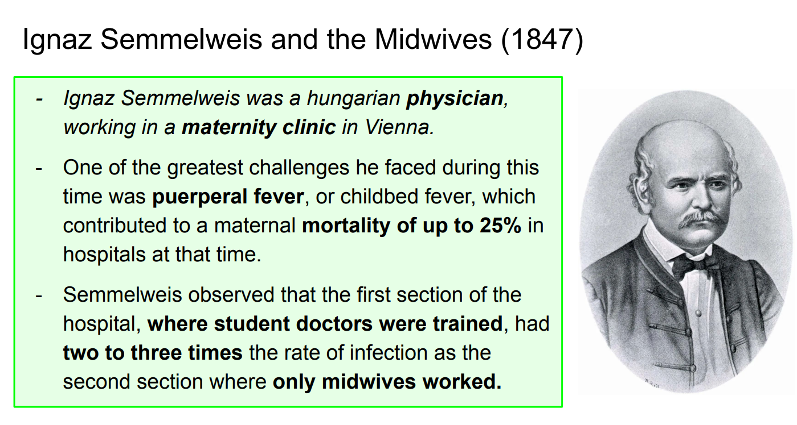

Slide 7
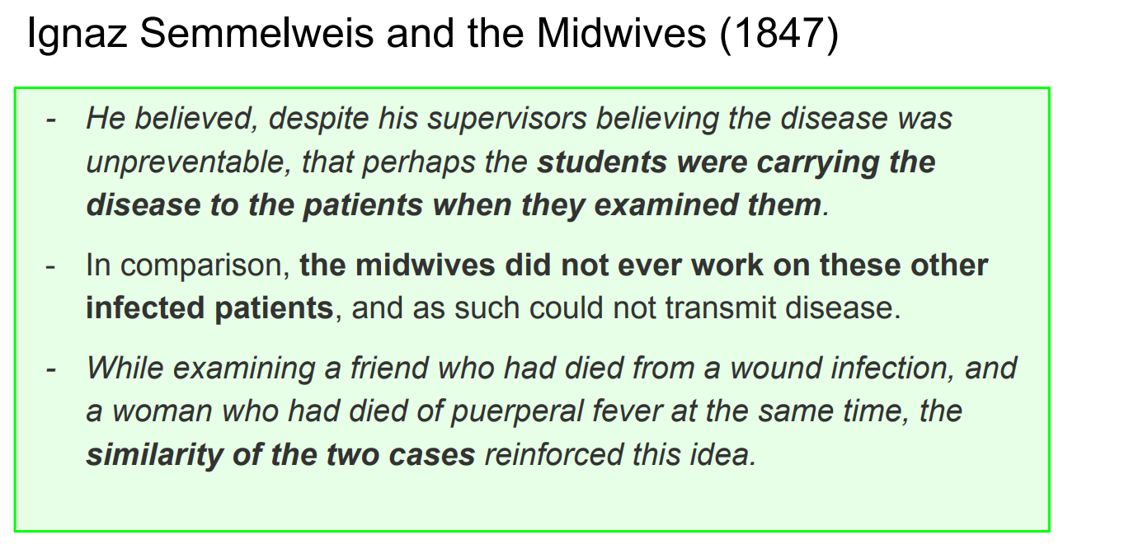

Slide 8
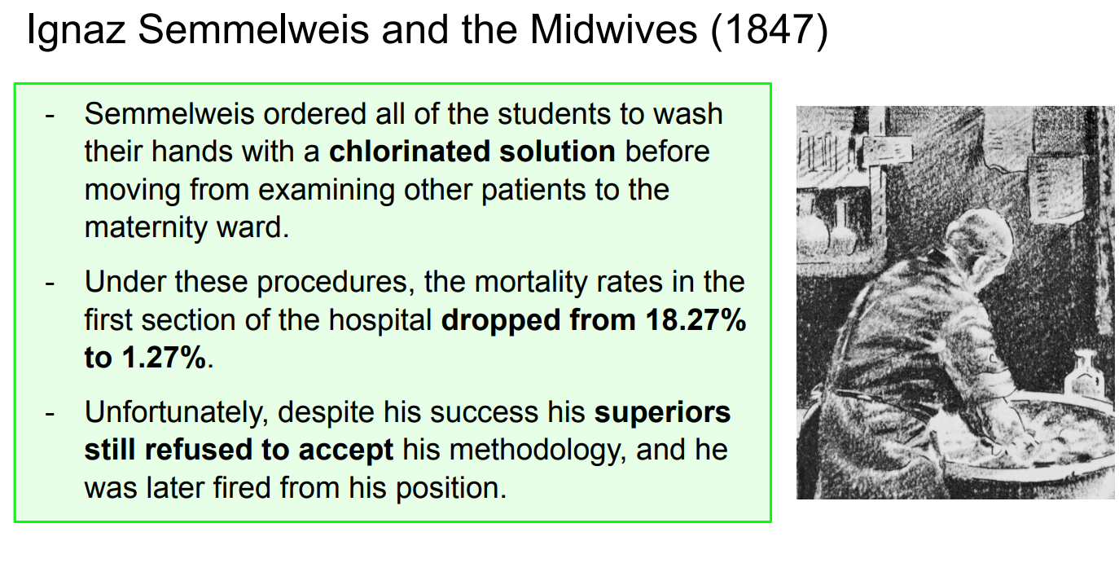

Slide 9
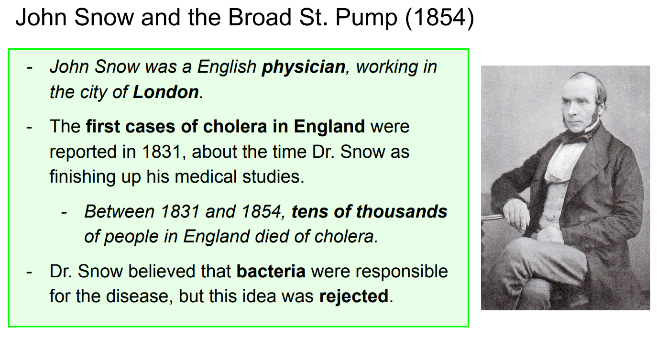

Slide 10
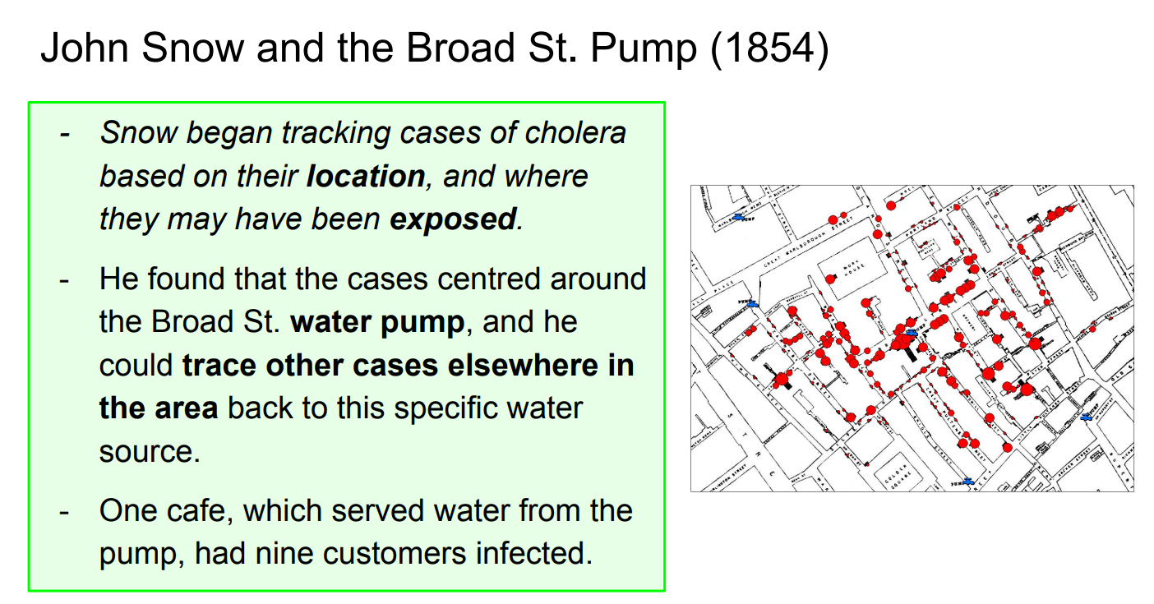

Slide 11
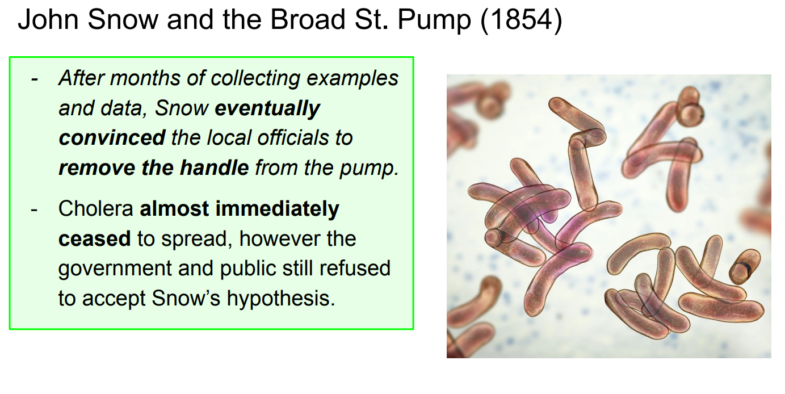

Slide 12
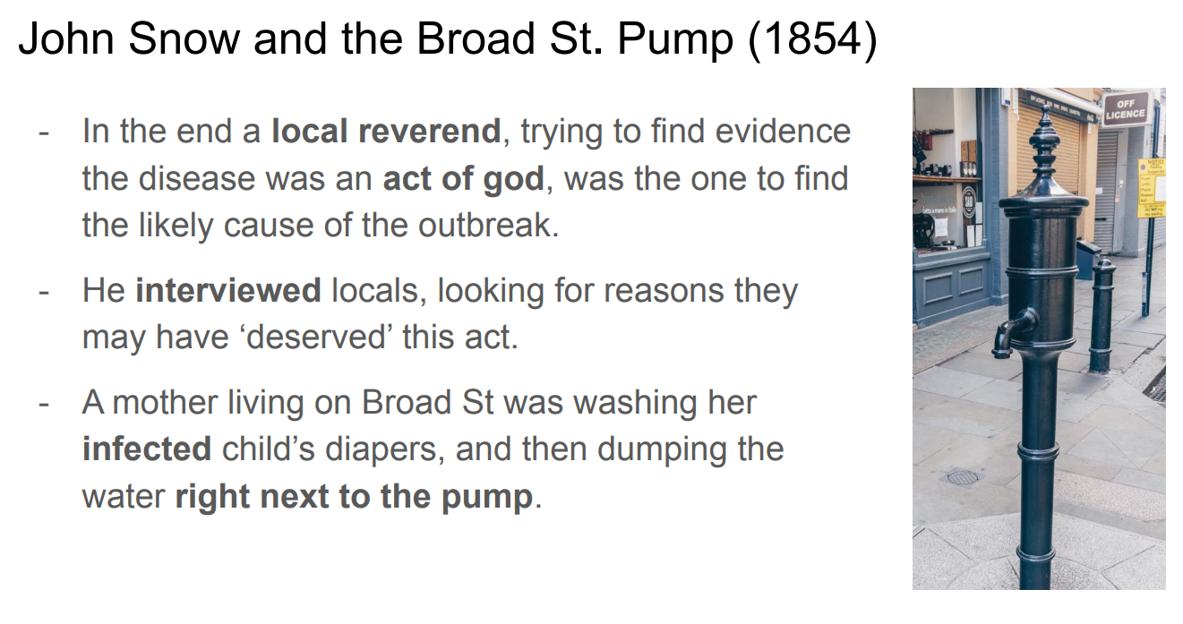

Slide 13
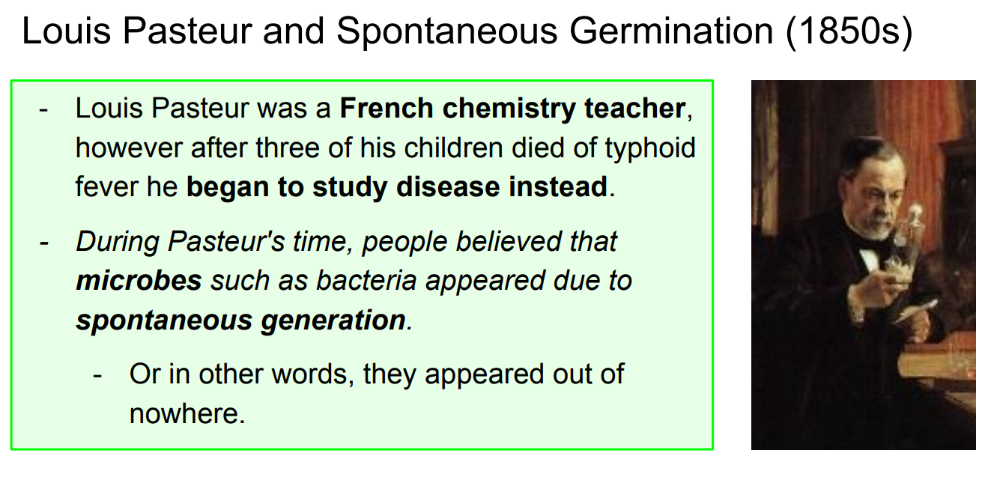

Slide 14
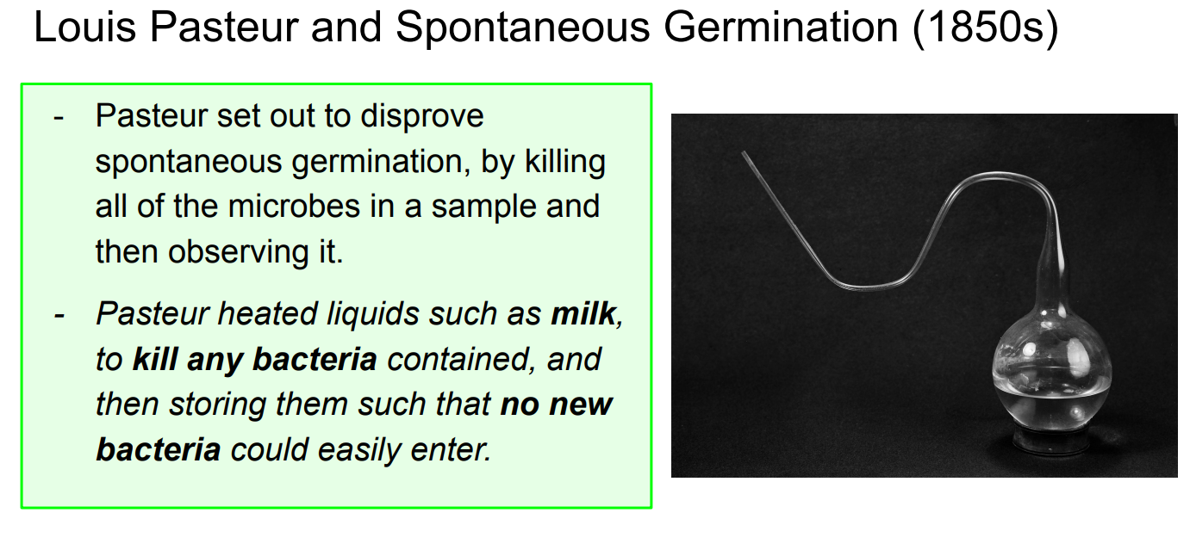

Slide 15
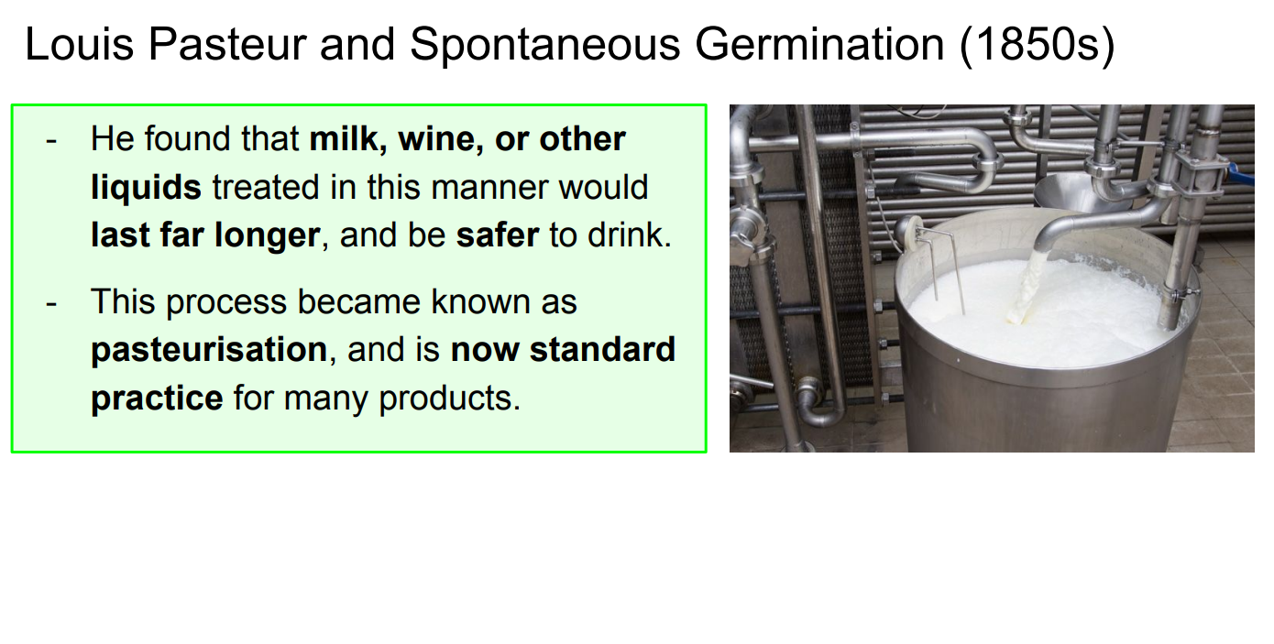

Slide 16
Share and research

Slide 17
Success Criteria
Explain how our understanding of infectious disease has evolved with developments in technology, including microscopes.

